Slide 1
Personal To-Do List Application
Simple Task Management Tool
Ayesha M

Slide 2
Introduction
Brief overview of the application
The goal is to help users manage tasks efficiently
Command-line interface with persistent storage

Slide 3
Key Features
Add, view, mark as complete, and delete tasks
Categorize tasks (e.g., Work, Personal, Urgent)
Automatic task saving to tasks.json
No database required, all data stored locally

Slide 4
Technology Used
Programming Language: Python
File Handling: JSON
Interface: Command-line interface (CLI)
Storage: Local JSON file for persistence

Slide 5
Application Structure
todo.py: Contains main logic and user interaction
tasks.json: Stores tasks (auto-created if missing)
/todo_app ├── todo.py ├── tasks.json

Slide 6
Running the Application
Ensure Python is installed
Navigate to the project folder
Run the application:
python todo.py

Slide 7
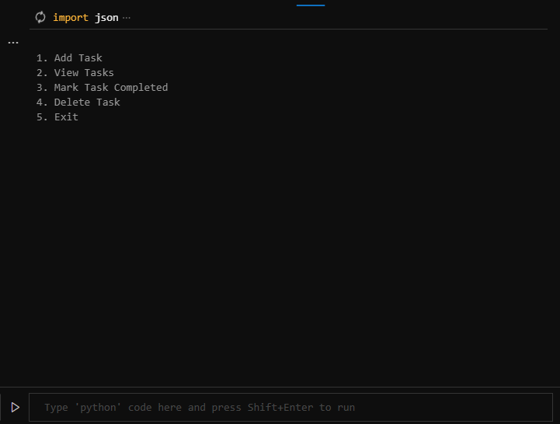
Main Menu
Options:
Add Task
View Tasks
Mark Task Completed
Delete Task
Exit

Slide 8
Adding a Task
Step-by-step process for adding a task
User enters title, description, and category
Example screenshot of input for adding a task

Slide 9
Viewing Tasks
Option 2 displays the list of tasks
Shows task title, category, description, and completion status
Example screenshot of task list

Slide 10
Marking a Task as Completed
Select option 3, choose the task number to mark as complete
Updates the task status to completed
Screenshot of how to mark tasks complete

Slide 11
Deleting a Task
Select option 4, choose task number to delete
Task is removed from the list and tasks.json
Screenshot of task deletion process

Slide 12
Automatic Task Saving
Tasks are saved automatically after every operation
Saved tasks are stored in tasks.json
Explains how the system loads tasks from the file when the application is restarted

Slide 13
Exiting the Application
Select option 5 to save tasks and exit the application
Ensure all changes are saved to tasks.json
Screenshot of exiting the application

Slide 14
Error Handling
Handles errors such as missing tasks.json by creating it automatically
Invalid input handling (task numbers, options)

Slide 15
Conclusion
Simple and Efficient Task Management: The Personal To-Do List Application allows users to easily add, categorize, and manage their tasks with minimal effort.
Persistent Local Storage: Tasks are automatically saved and loaded from a JSON file, ensuring that user progress is retained between sessions without the need for a database.
User-Friendly Command-Line Interface: The application provides clear prompts and feedback, making it easy for users to interact and manage their tasks in a straightforward, accessible way.

